Slide 1
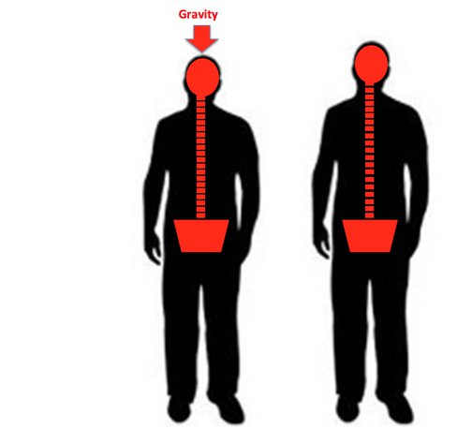
Understanding Height Dynamics Through Regression
Jackie Harmon

Slide 2
Introduction
Background:
It is a well-known phenomenon that our height decreases throughout the day due to gravitational compression. Height measured in the evening is often less than in the morning.
This project investigates this effect using AM and PM height measurements from students at a boarding school in India.
Objective:
To explore the relationship between morning (AM) and evening (PM) heights using regression analysis to quantify the impact of gravity on daily height variation.

Slide 3
Dataset Overview
Source:
Data collected from students at a boarding school in India.
Variables:
AM height measurements (in mm).
PM height measurements (in mm).
Sample Size:
Number of observations: 150 students (as per the data available)

Slide 4
Methodology
Tools Used:
In R
ggplot2 for visualization
lm() for linear regression
gvlma for global validation of linear model assumptions
predictmeans for calculating predicted means and diagnosing residuals
car for diagnostic tests (e.g., detecting outliers, testing homoscedasticity)
caret for model training, tuning, and cross-validation
Tools Used:
In Python
Pandas for data manipulation
NumPy for numerical operations
SciPy for statistical testing
Matplotlib and Seaborn for visual analysis
statsmodels for regression modeling and diagnostics
pylab for plotting and visualization utilities

Slide 5
Methodology
Analysis Steps
Data Cleaning and Preparation: Ensured dataset quality and readiness for analysis.
Linear Regression: Modeled the relationship between AM and PM heights.
Assumptions Testing:
Linearity
Normality
Homoscedasticity
Outlier Detection
Leverage and Influence

Slide 6
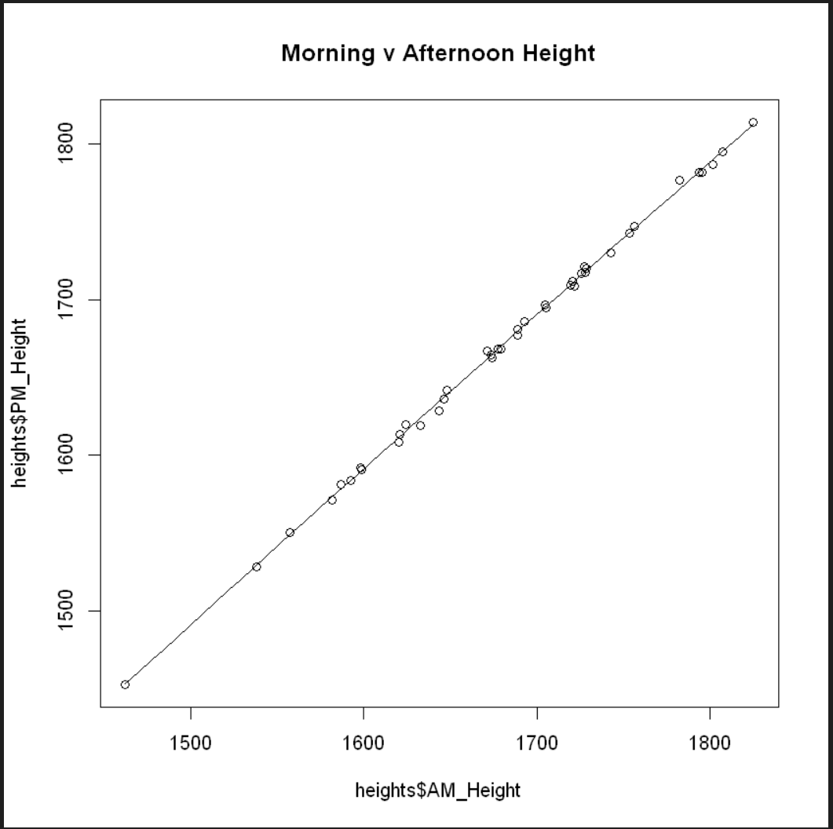
Assumptions Testing - Linearity
In R
A scatter plot was used to visually assess the linearity between AM and PM heights.
Visual inspection indicated a linear relationship, which justified using a linear regression model.

Slide 7
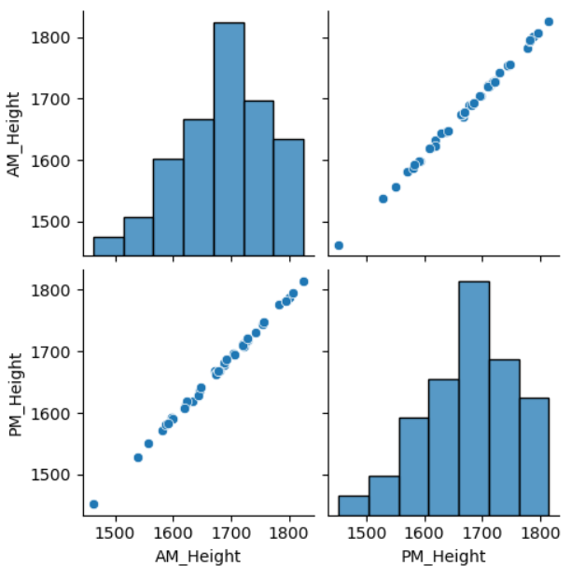
Assumptions Testing - Linearity
In Python
A scatter plot was also utilized to check for linearity.
The linear relationship was confirmed by observing the plot, validating the use of linear regression.
A Harvey Collier test was conducted with a p-value larger than 0.05, suggesting the linear model is appropriate

Slide 8
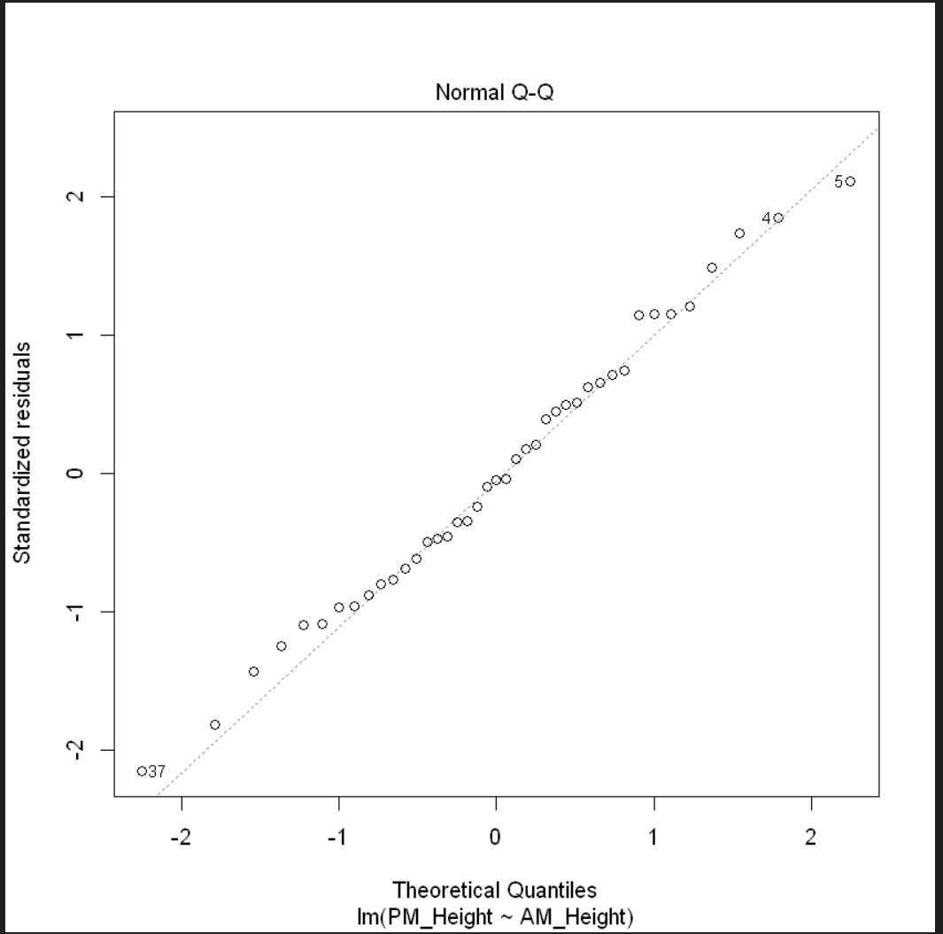
Assumptions Testing - Normality
In R
QQ plot was employed to visually evaluate the normality of residuals.

Slide 9
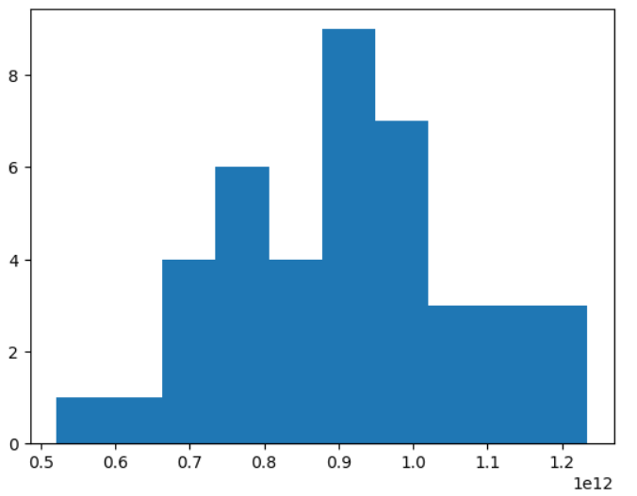
Assumptions Testing - Normality
In Python
Box-Cox Transformation: The histogram of the transformed data shows a more normal distribution compared to the original data, indicating successful variance stabilization.

Slide 10
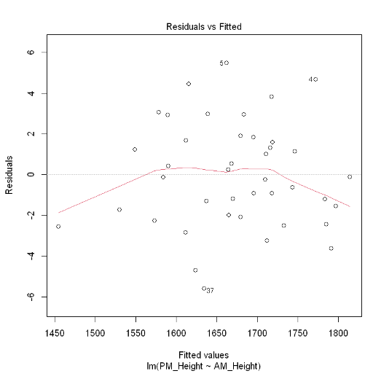
Assumptions Testing - Homoscedasticity
In R
Residual vs. Fitted Plot: The residuals exhibited constant variance across fitted values, indicating homoscedasticity.
Breusch-Pagan Test: Confirmed homoscedasticity with no significant heteroscedasticity detected.
Non-Constant Variance Test: Confirmed homoscedasticity with no significant heteroscedasticity detected.

Slide 11
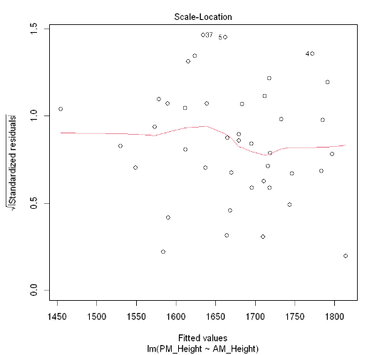
Assumptions Testing - Homoscedasticity
In R
Scale-Location Plot: The residuals exhibited no clear pattern, with red line roughly horizontal, indicating homoscedasticity.

Slide 12
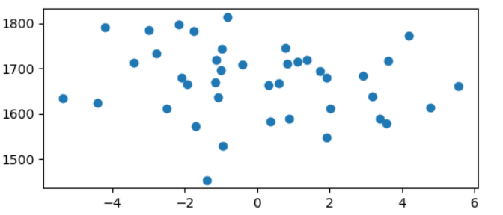
Assumptions Testing - Homoscedasticity
In Python
Homoscedasticity:
Residual plot: residuals showed no clear pattern, confirming homoscedasticity.
Breusch-Pagan test with significant p-value

Slide 13
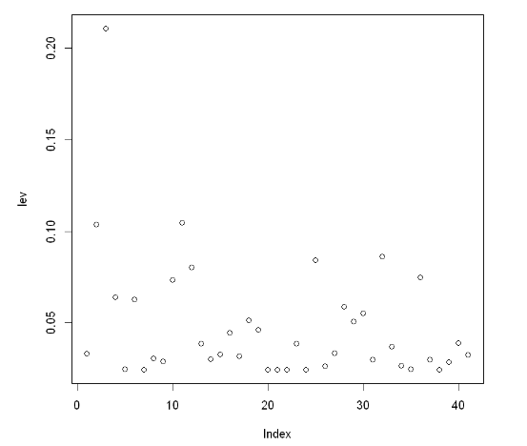
Outlier Detection
In R
GVLMA Test: Overall model diagnostics confirmed assumptions and model integrity.
Screening for Outliers in X Space:
Cook's Distance: Identified and addressed influential outliers, ensuring they did not unduly affect the model.
Leverage Values: Detected high-leverage points, with appropriate adjustments made.
Screening for Outliers in Y Space: Identified outliers in the response variable.

Slide 14
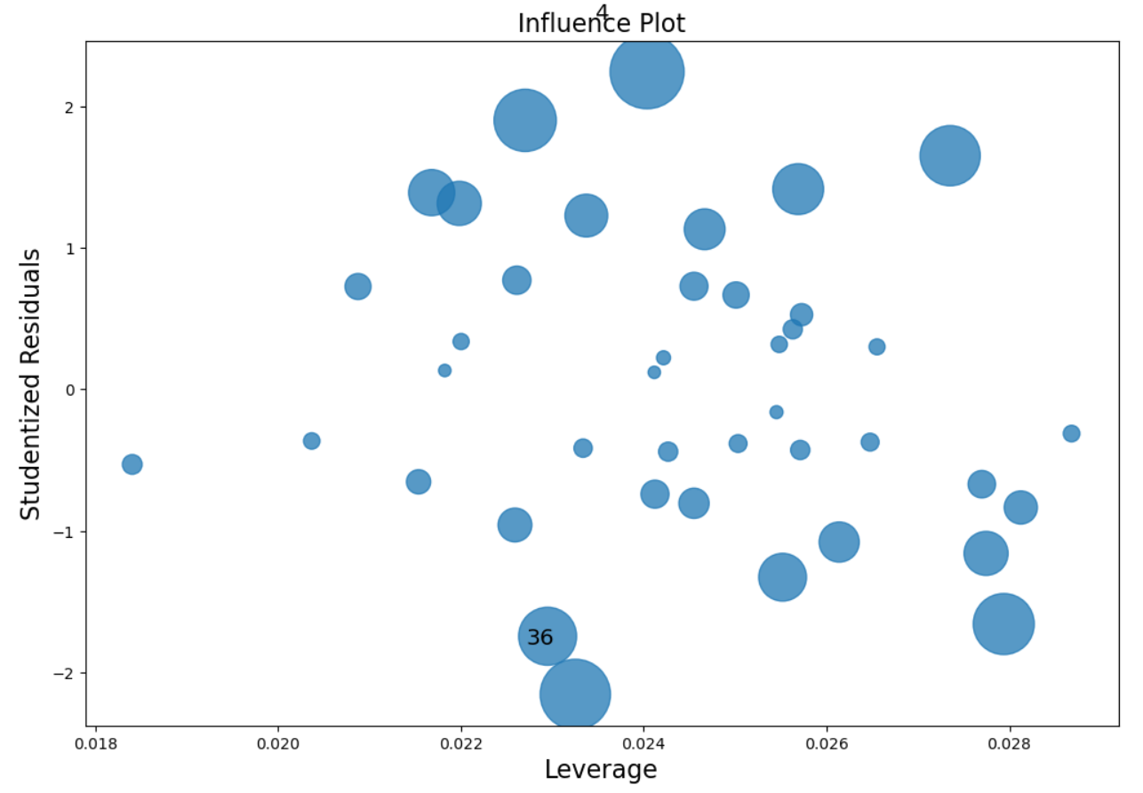
Outlier Detection
In Python
Influence Plot: Observations with high leverage and large studentized residuals, particularly those with a large Cook's distance, flagged as influential

Slide 15
Regression Analysis in R
Model Summary:
R-squared value: 0.9989, indicating 99.89% of the variance in PM heights is explained by AM heights.
The residuals appear to be symmetrically distributed around zero, indicating a good fit.
The residual standard error of 2.627 is relatively small, suggesting that the model predictions are close to the actual values.
Significant slope coefficient (p-value < 0.05) confirms the effect of gravitational compression.
Assumptions Validation:
Tests confirmed assumptions were met or adjusted for.
Transformation applied to improve model fit.

Slide 16
Regression Analysis in Python
Model Summary:
Similar R-squared value and statistical significance observed as in R analysis.
Model confirmed findings from R analysis, reinforcing the conclusions.
Assumptions Validation:
Consistent validation of assumptions across both platforms.

Slide 17
Key Findings
Daily Height Reduction:
Height measurements confirm a decrease from morning to evening, attributed to gravitational effects.
Statistical Significance:
Both R and Python analyses indicate a significant correlation between AM and PM heights.
Implications:
Highlights the importance of considering time of day in height-related measurements for research and health assessments.

Slide 18
Conclusions
Summary:
The project successfully demonstrated the measurable impact of gravity on daily height variations.
Showcased proficiency in using R and Python for data analysis, modeling, and assumption testing.
Future Work:
Investigating other factors influencing height variation, such as age or posture, and expanding the study to different populations.

